Slide 1

First shot:
Notes:
Paid/owned/earned.

Slide 2






Background/Brief
Jameson First Shot True View Campaign
The Concept:
Jameson’s competition offered consumers the chance to write and direct a 5 minute film starring Kevin Spacey based on ‘a legendary, humorous or very tall tale’
In-Stream
In-Display
The Media:
The Objective:
Ensure maximum video views & engagement achieved on YouTube.
Target Demographic : 25-34YO then wider film & entertainment 18-30YO audience
Budget: $500,000
In-Search
In-Slate

Slide 3


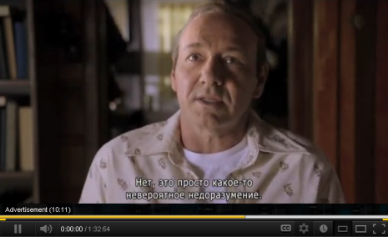









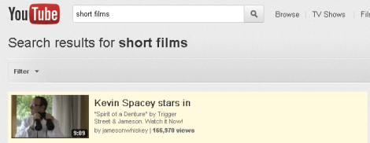
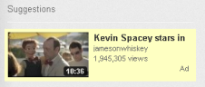
Strategy
YOUTUBE TRUE-VIEW AD FORMATS
Topic

Slide 4

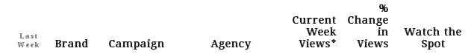
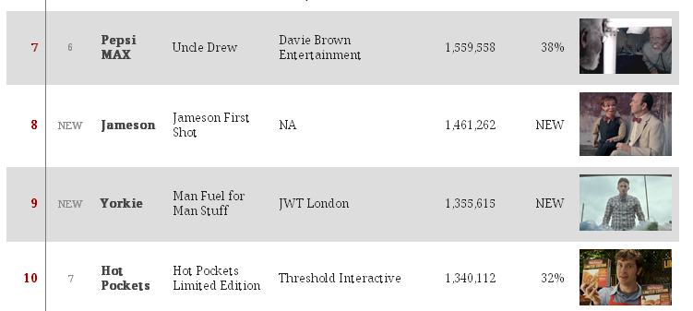

results
VIRAL TOP 10
.
The RESULTS:
this campaign generated 72% of views across all their videos and is responsible for 69% of all subscribers currently subscribed to the channel .
The Achievement:
iProspect broke into the “Top 10 Viral Video Chart”.
This campaign’s success acted as a showcase for TrueView activity for Jameson’s to want to repeat it.
2,996,381 PAID MEDIA VIEWS
1MILLION+ EARNED VIEWS
http://adage.com/article/the-viral-video-chart/jameson-taps-kevin-spacey-cracks-viral-chart/235348/

Slide 5
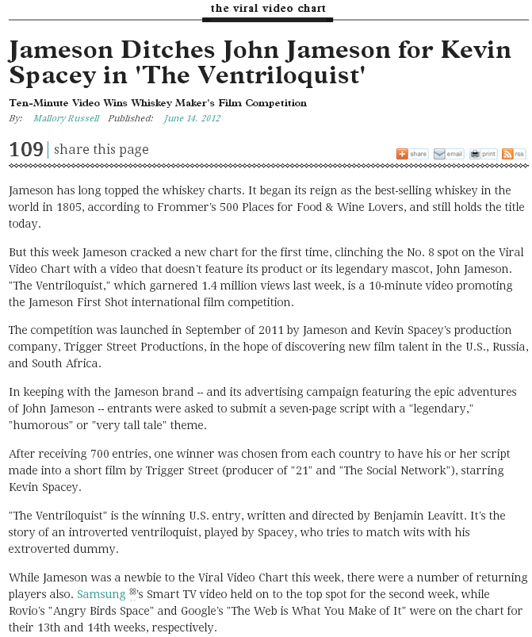
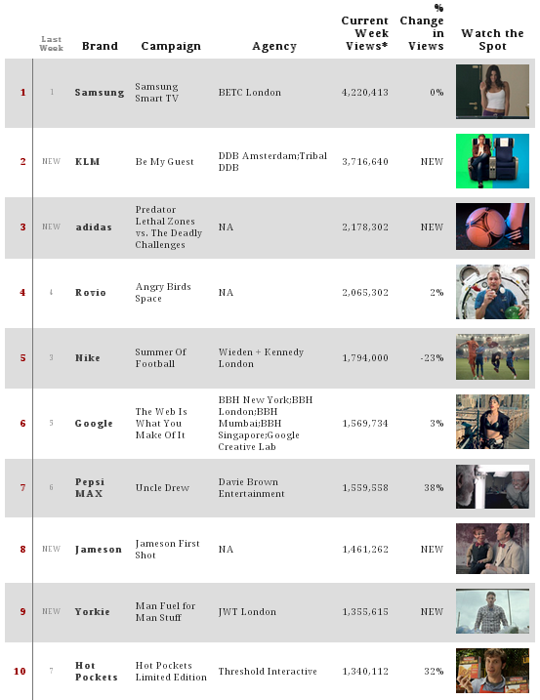
press

